Slide 1
Welcome to Hell Runners (in Space)
By Joey, Derick, and Mario

Slide 2
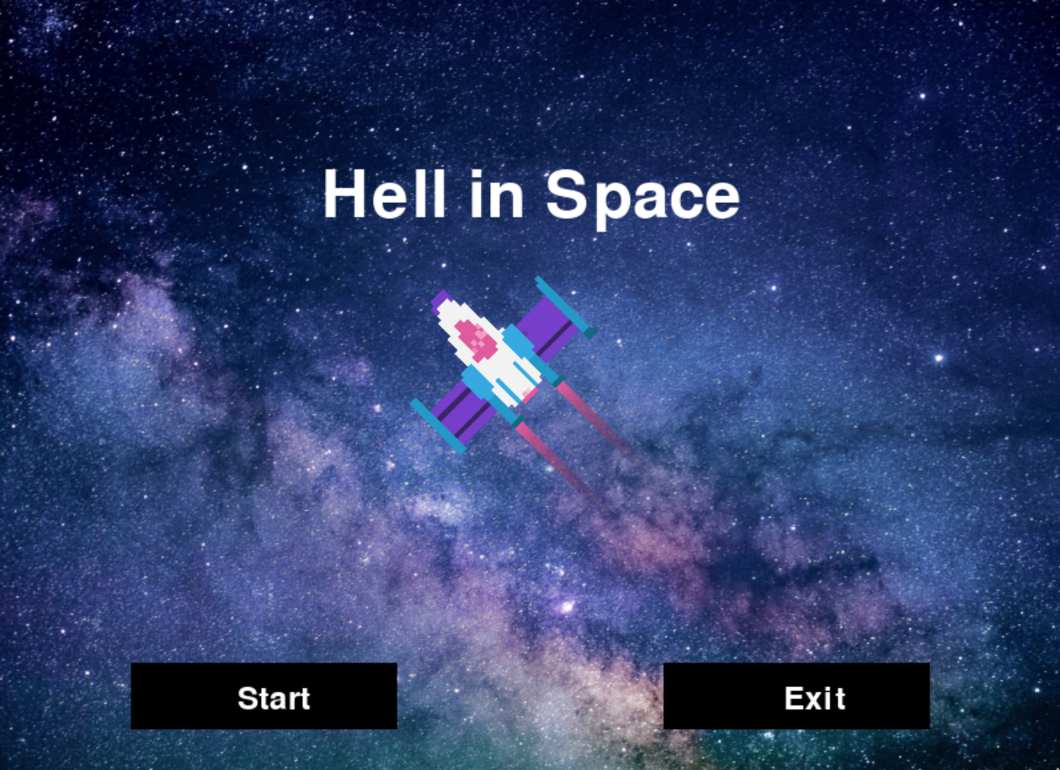
Since we are no-good newbie programmers who are up to no good, we decided to take the base code of the asteroid infinite runner game and evolve it into a more applicable game.

Slide 3
Overview:
User interface with start and continue menu
Music and sound effects
Move ship with mouse
Avoid randomly generated asteroids
Increase highscore/score the longer you survive
Difficulty increases the longer the game lasts

Slide 4
However, since the base code relied on that pesky p5 library, we had no clue what to do so we decided to remake the game using pygame
p5

Slide 5
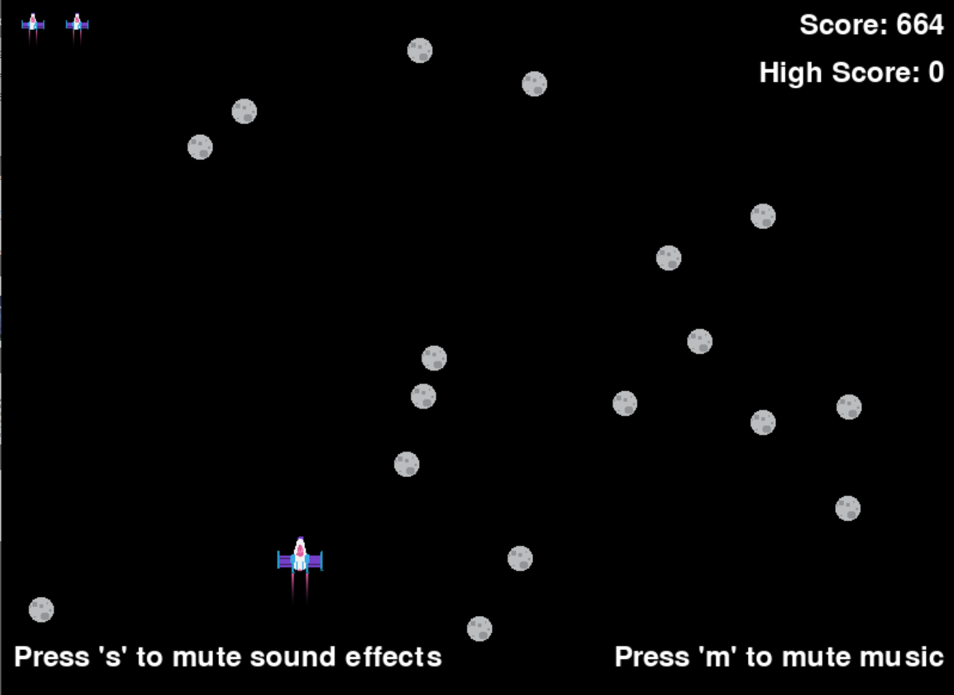
Epic Gameplay!!!
(With added sounds effects and cool music too!)

